Slide 1


UE 4 Artificial Intelligence for Finance
Group Project
Kevin Da Silva | Louise Dietrich | Maéva Mecker | Alberto Monari

Slide 2

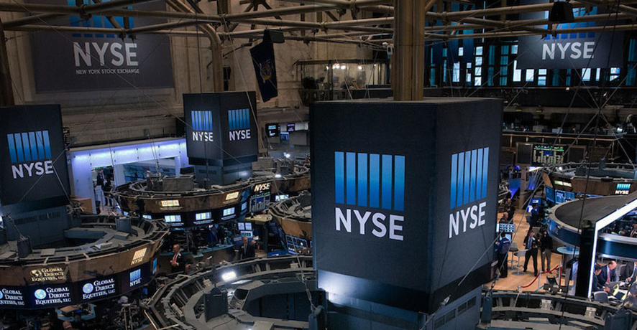
New York Stock Exchange Price Prediction
Using Recurrent Neural Network with TensorFlow
01
AI MODEL
02
FINANCIAL APPLICATION
03
CONCLUSION

Slide 3
New York Stock Exchange Price Prediction
01
AI MODEL
02
FINANCIAL APPLICATION
03
CONCLUSION

Slide 4

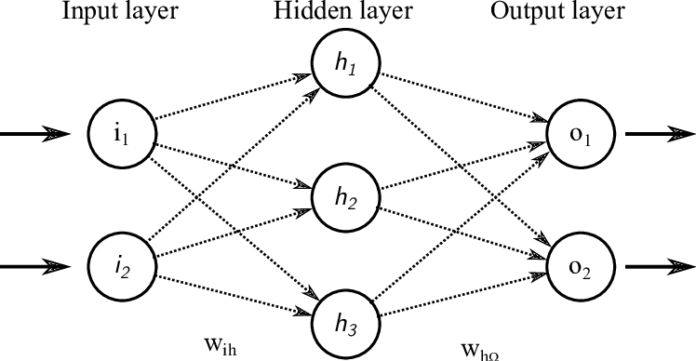
01
AI MODEL
Artificial Neural Networks are a collection of connected nodes, made of neurons and edges.
A neuron receiving a signal processes it with some non-linear function of the sum of its inputs, then transmit it to its connected neurons through the edges.
Edges and neurons usually have a weight that adjusts during the learning process.

Slide 5

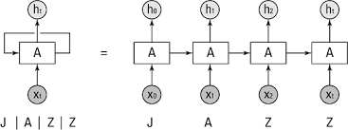
01
AI MODEL
Recurrent Neural Networks (RNN) are a class of Artificial Neural Networks that can process a sequence of inputs in deep learning and retain its state while processing the next sequence of inputs. It is a powerful model for data such as time series or natural language.
The principle is as follow:
A sequence of inputs are passed through a RNN cell, one by one
The state of the cell remember the past sequence
The past information is combined with the current input to provide the output
When we unfold what is happening as a sequence is going through the neuron, it reveals a simple Deep Network.

Slide 6

02
FINANCIAL APPLICATION

Slide 7
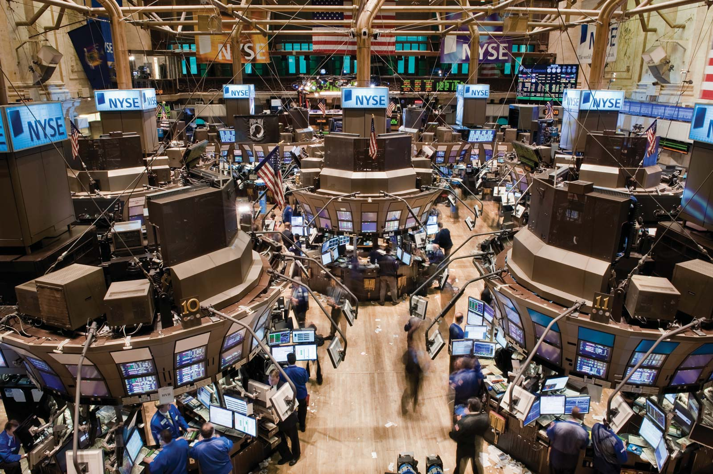
02
FINANCIAL APPLICATION
The New York Stock Exchange (NYSE, nicknamed "The Big Board") is an American stock exchange at 11 Wall Street in the Financial District of Lower Manhattan in New York City. It is by far the world's largest stock exchange by market capitalization of its listed companies at 30.1 US dollars trillion as of February 2018.
It is extremely hard to predict the stock market. Stock market prediction is the act of trying to determine the future value of a company stock. Predicting such an unstable market in which many external factors come into play is very difficult.
We focused on the company Netflix, which is quoted in the NYSE, to try to predict the future price variations of its stock values.
Netflix is an American company which primary business is a subscription-based streaming service offering online streaming from a library of films and television series, including those produced in-house.

Slide 8

02
FINANCIAL APPLICATION
We applied a Recurrent Neural Network to predict stock prices data of Netflix.
The daily data spans from the beginning of 2010 to the end of 2016, and consists of:
The date of the day considered
The symbol of the company
The stock price at the opening of the market
The stock price at the closing of the market
The lowest price achieved during the day
The highest price achieved during the day
The volume of transactions
The dataset contains the stock prices of all companies listed on the NYSE, so we had to filter the prices with the symbol corresponding to Netflix (NFLX).
date | symbol | open | close | low | high | volume
04/01/2010 | NFLX | 7.93142842856 | 7.63999985714 | 7.56571442856 | 7.96142857142 | 17239600.0
05/01/2010 | NFLX | 7.65285728571 | 7.35857157142 | 7.25857157142 | 7.65714257142 | 23753100.0
06/01/2010 | NFLX | 7.36142871428 | 7.61714271428 | 7.19714314285 | 7.67285728571 | 23290400.0
07/01/2010 | NFLX | 7.73142857142 | 7.48571442856 | 7.46285728571 | 7.75714299999 | 9955400.0
08/01/2010 | NFLX | 7.49857142856 | 7.61428599999 | 7.46571442856 | 7.74285699999 | 8180900.0
11/01/2010 | NFLX | 7.65999985714 | 7.60428571428 | 7.52857157142 | 7.70428557142 | 6783700.0
12/01/2010 | NFLX | 7.52857157142 | 7.48142857142 | 7.45142842856 | 7.58285714285 | 6330100.0
13/01/2010 | NFLX | 7.61285728571 | 7.70857142856 | 7.55857128571 | 7.75428585714 | 14422100.0
14/01/2010 | NFLX | 7.51857142856 | 7.28428557142 | 7.26999999999 | 7.57571414285 | 17685500.0
15/01/2010 | NFLX | 7.24571414285 | 7.27857157142 | 7.23285728571 | 7.40714257142 | 13031200.0
19/01/2010 | NFLX | 7.24999999999 | 7.31428571428 | 7.24285699999 | 7.38285728571 | 5302500.0
20/01/2010 | NFLX | 7.26571414285 | 7.32000014285 | 7.22142842856 | 7.49285699999 | 9685200.0
21/01/2010 | NFLX | 7.21714299999 | 7.31285714285 | 7.21428585714 | 7.45428557142 | 8614900.0
22/01/2010 | NFLX | 7.29714299999 | 7.26999999999 | 7.21428585714 | 7.48428585714 | 9395400.0
25/01/2010 | NFLX | 7.29285714285 | 7.01857142856 | 6.93142842856 | 7.35714285714 | 13791400.0
26/01/2010 | NFLX | 6.95999999999 | 7.13571399999 | 6.93714285714 | 7.17857128571 | 11343500.0
[Data Source]

Slide 9




Road Map
Cleaning data
Findings -> Insights
The data had already been cleaned. But to display dates on our plots we create a new column and change the format to datetime.
However, an important step in our model was to normalize it to range the price in an interval between 0 and 1. It is useful to compare different stocks but above all it allows the neural networks to function optimally.
After training and validating the model, we passed the data from the testing set through the Recurrent Neural Network to provide an unbiased evaluation of the final model.
We obtained a 0.59 accuracy score on predicting correctly if the value of the stock would increase or decrease during the day.
That accuracy score can be considered as rather good considering that the fluctuation of stock prices depends on many other factors than the previous values it has reached.
Business question
Methodology
How to predict price changes on the New York stock exchange using deep learning and neural network ?
We will use a Recurrent Neural Network to predict the future changes on stock prices.
Data
Context
We obtained the data from https://www.kaggle.com/dgawlik/nyse. It is composed of 140 stocks between 2010 and 2016
Today it is said that 30% of traffic on stocks is already generated by machines, but humans keep working on trading. Can it be fully automated ? It would be interesting to be capable of predict the stock prices using historical data, to know better the places to invest.
Intuition -> Hypothesis
The problem with stock prices is that the simple use of historical data can only predict future prices with little certainty. Indeed, the stock market is very dependent on many external factors that will affect stock market behaviour.
Therefore, it is very likely that our model is not perfect and that we still have a lot to learn from historical data.
Recommendations
The predictions resulting from this model should be considered with caution, as considering only historical data for stock market values presents some bias.
In this model we are not able to foresee other factor that could have influence on the stock prices, such as a company performance, or a change in the economic climate.
Stakeholders
People working in the financial world, traders, banks, companies, or even individuals who would like to invest in the stock market would be interested in a prediction model to confirm their intuitions.
Analysis goals
The aim of this project is to predict the share prices of companies listed on the New York Stock Exchange using Python and deep learning

Slide 10

02
FINANCIAL APPLICATION
The Netflix stock data has been splitted: 90 % for the train set, 5% for the validation and 5% for the test set.
The training set is the set in which the neural network is trained and the validation set is the set in which we validate our algorithm. The test set is a set of data that we imagine we do not have yet (i.e. a future prediction of our stock) although actually in this model we take a test set of which we have the actual stock values, so we can calculate a score on this set as well.
The stock prices were normalized by the stock volume, and we have 4 inputs for our RNN :
Opening price
Closing price
Highest price of the day
Lowest price of the day
Our RNN has 200 neurons dispatched in 2 layers, and it will return 4 outputs corresponding to the same features as the inputs. These 4 outputs are stacked to compute the final prediction.

Slide 11
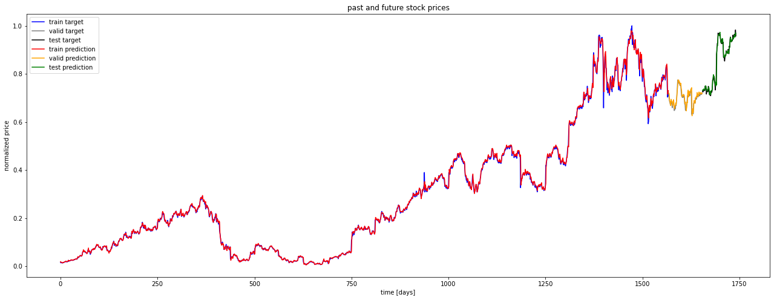
02
FINANCIAL APPLICATION
These are our results visualized: the entire stock (2010 to 2016) with the actual values and our predicted values.

Slide 12
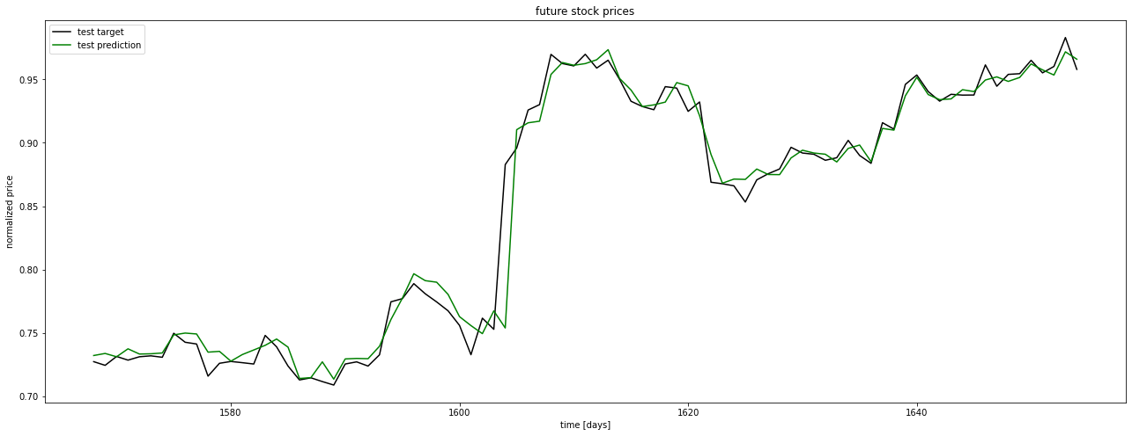
02
FINANCIAL APPLICATION
Here there are our results with a zoom on the test set (which makes a prediction on the last 3 months or so of 2016).

Slide 13

03
CONCLUSION

Slide 14
03
CONCLUSION
Validation: To assess the validity of our model that aim to forecast future price variations of the Netflix stock values, we look at the sign predictions for close – open prices (i.e., if the price has increased or not during the day).
For our forecast assessment we only calculate a score based on a binomial classification: i.e. whether on that day we predicted the stock price to go up or down.
We are not concerned with how much the price actually went up or down.
The accuracy of the predictions is displayed in the table below:
Correct sign prediction | Train set | Validation set | Test set
 | 0.53 | 0.55 | 0.59

Slide 15
03
CONCLUSION
How can we improve our model?
The results of our RNN seem quite satisfying considering that the variation of stock markets values are difficult to predict. We should nonetheless consider with caution the model’s predictions over the next periods.
Indeed, the number of factors to acknowledge goes far beyond the previous values that a stock had (e.g.: the performance of the company, of its business sector, the economic climate,… ), and none of these elements can be anticipated in this model.
Technical analysis is not the only component for predicting share price movements; to get a better score, one would have to integrate an analysis of the surrounding conditions that may affect a particular stock.

